Slide 1



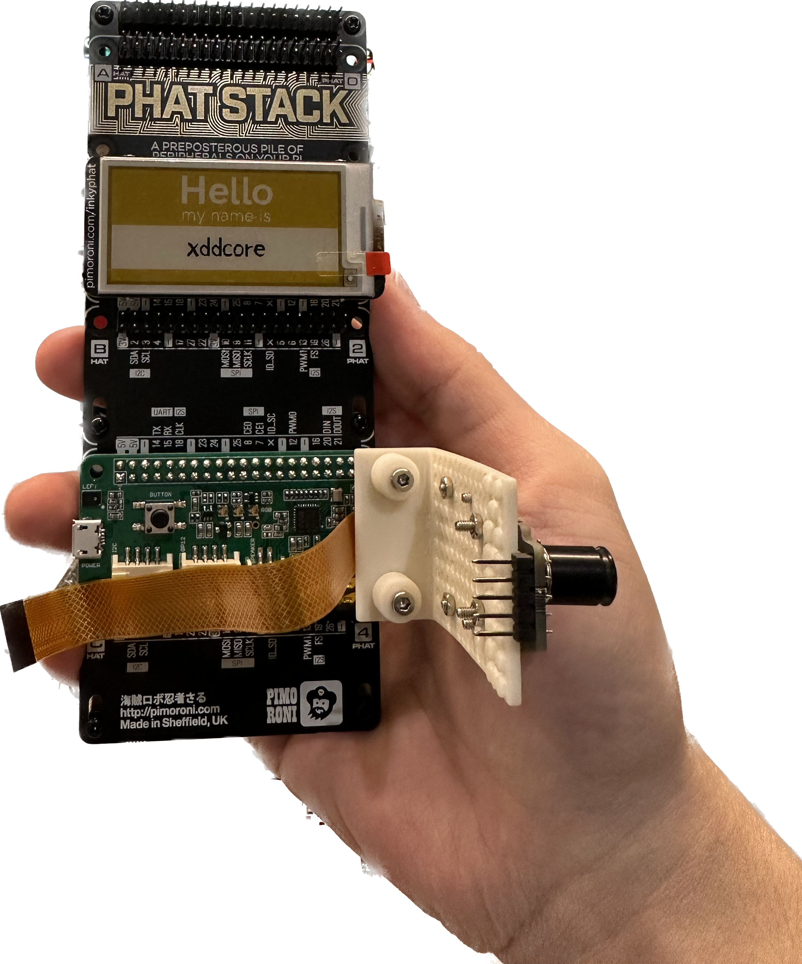

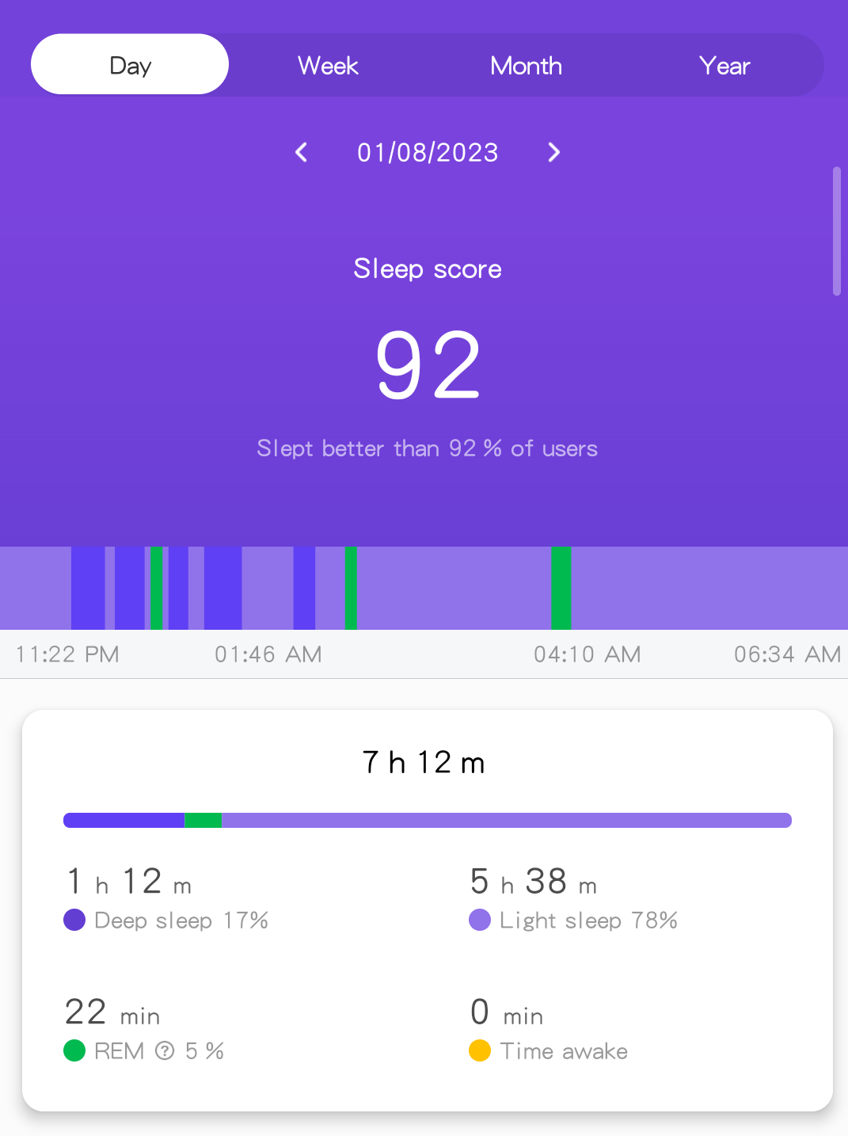









Sleep Panda: Your personal sleep manager
Step 1: Sleep Monitoring
Model Design Drawing
Example Sleeping Report
Raspberry Pi 4b
(bcm2711)
Step 2: Data Processing
Main Device Type
Sensor：
Sleeping position observation: 4K 30FPS
Heart rate & blood oxygen: MAX30101
Body temperature & gesture control: MLX90640
Speaker & Microphone: WM8960
Actuator：
Ink Screen: Virtual Zoo
Touchscreen: QT-based GUI
Buzzer: emergency abnormal alarm
Team 2: Sleep Panda
Rui Liu (2756138L)
Notes:
招呼
介绍a sleep monitoring system called Sleep Panda
首先，LOGO, lovely sleepy Panda, 你懂得，If you don't sleep regularly you will have dark circles under your eyes like a panda. 没关系，SP来了
based on Raspberry Pi 4b, uses a variety of sensors to collect sleep data from users
睡觉时，type camera observe your sleeping position，type Photoelectric 和temperature，record
当然If you're snoring, the microphone will work.
After that，these data will be analyzed by DSP, CNN and other algorithms. It will generate a daily sleep report for the user. Like this, You can see The time you go to sleep and wake up. And, after systematic analysis, we have classified sleep states into deep sleep, light sleep and awake. You can find them all on this report. At the same time, you can share the report with your friends. So当然，另一个Usage，When one night your boyfriend says：亲爱的，I’m so sleepy, I’m going to bed. Even though it was only 9pm, BUT okay. Then the next day, you check his sleep report and find out that his real bedtime is 3am. 有意思 You know what you'll do.
In addition, we have other functions, such as alerting when when high body temperature is detected, playing sleep-aiding music when falling asleep, etc.
事实上，Big Plan，Virtual Zoo，As long as you sleep on a daily schedule, you will receive a virtual pet, which could be a kitten or a puppy or any other animal you like. You can even swap your pets with your friends. Sounds difficult，Try our best
Good luck，Thanks

